Slide 1


AUTOMATING STORED PROCEDURE THROUGH TASKS

Slide 2
WHAT IS THE STORE PROCEDURE
A stored procedure contains logic you write so you can call it from SQL.
A stored procedure’s logic typically performs database operations by executing SQL statements.
With a stored procedure, you can also:
Dynamically create and execute SQL statements.
Execute code with the privileges of the role that owns the procedure, rather than with the privileges of the role that runs the procedure.
This allows the stored procedure owner to delegate the power to perform specified operations to users who otherwise could not do so.
A stored procedure is created with a CREATE PROCEDURE command and is executed with a CALL command.

Slide 3
Usage Notes
For all stored procedures:
Stored procedures support overloading. Two procedures can have the same name if they have a different number of parameters or different data types for their parameters.
Stored procedures are not atomic; if one statement in a stored procedure fails, the other statements in the stored procedure are not necessarily rolled back. For information about stored procedures and transactions, see Transaction Management.
CREATE OR REPLACE <object> statements are atomic. That is, when the object is replaced, the old object deletion and the new object creation are processed in a single transaction.
For JavaScript stored procedures:
A JavaScript stored procedure can return only a single value, such as a string (for example, a success/failure indicator) or a number (for example, an error code). If you need to return more extensive information, you can return a VARCHAR that contains values separated by a delimiter (such as a comma), or a semi-structured data type, such as VARIANT.

Slide 4
Drawbacks of Using Stored Procedures
If we use stored procedures, the memory of every connection that uses those stored procedures will increase substantially. Also, if we overuse many logical applications inside stored procedures, CPU usage will increase. It is because the database server is not well-designed for logical operations.
Stored procedure constructs are not designed to develop complex and flexible business logic.
It is challenging to debug stored procedures. Only a few database management systems allow us to debug stored procedures. Unfortunately, MySQL does not provide facilities for debugging stored procedures.
It is not easy to develop and maintain stored procedures. Developing and maintaining stored procedures are often required a specialized skill set that not all application developers possess. It may lead to problems in both the application development and maintenance phases.

Slide 5
Task Vs Procedure
Tasks and procedures are both objects in Snowflake that can be used to automate tasks and simplify workflows. However, there are some key differences between the two.
Definition: A procedure is a stored SQL script that can be executed on demand by a user or another script. A task, on the other hand, is a predefined set of SQL commands that are scheduled to execute at a specific time or interval.
Execution: A procedure can be executed by a user or another script, typically in response to a specific event or trigger. A task, on the other hand, is scheduled to run automatically according to a predefined schedule or trigger.
Parameters: Procedures can accept input parameters, which can be used to customize the behavior of the script at runtime. Tasks do not accept input parameters, but they can reference other objects in the Snowflake account, such as tables or views.
Results: Procedures can return output values or result sets, which can be used by the calling script or user. Tasks do not return any output, but they can write results to a log table or file.
Recurrence: Tasks can be scheduled to run repeatedly according to a predefined schedule or trigger, such as hourly, daily, weekly, or monthly. Procedures are typically executed on demand and do not have a recurring schedule.
Overall, procedures and tasks serve different purposes in Snowflake, but they can be used together to automate complex workflows and simplify data processing tasks.

Slide 6
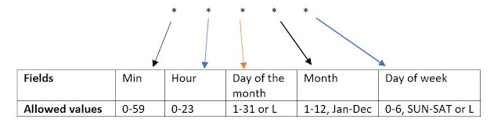
CRON

Slide 7


THANK YOU

